Slide 1
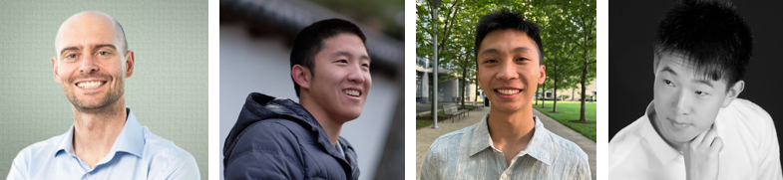
CS294-158 Deep Unsupervised Learning
Lecture 1 Intro: Logistics and Motivation
Pieter Abbeel, Wilson Yan, Kevin Frans, Philipp Wu

Slide 2
Instructor Team
Pieter Abbeel, Wilson Yan, Kevin Frans, Philipp Wu

Slide 3
Communication
Website: https://sites.google.com/view/berkeley-cs294-158-sp24/home
Announcements
Ed -- sign up today! – if you are registered or on the waitlist, we already added you
Questions
Ed (preferred!)
cs294-158-staff@lists.berkeley.edu
Office hours: [starting next week]
Pieter: Thu 5-6pm -- 250 Sutardja Dai Hall
Wilson: TBD
Kevin: TBD
Philipp: TBD
For homework, TA office hours are the best venue. For other questions (lecture, final project, research, etc.) any office hours should be great fits

Slide 4
Admission into the Course
Not everyone is going to make it in given class size constraints
We’ll remove students who don’t have a strong HW1, which will open up slots
And if you are hoping to make it, make sure to submit a strong HW1!
Everyone welcome to audit / submit HW

Slide 5
Syllabus
Week 1 (1/18) Intro
Week 2 (1/25) Autoregressive Models
Week 3 (2/1) Flow Models
Week 4 (2/8) Latent Variable Models
Week 5 (2/15) Generative Adversarial Networks / Implicit Models
Week 6 (2/22) Diffusion Models + Final Project Discussion
Week 7 (2/29) Self-Supervised Learning / Non-Generative Representation Learning
Week 8 (3/7) Strengths and Weaknesses of Unsupervised Learning Methods
Week 9 (3/14) Semi-Supervised Learning; Unsupervised Distribution Alignment
Week 10 (3/21)Compression
Spring Break Week (no lecture)
Week 11 (4/4) Language Models
Week 12 (4/11) Midterm; Multimodal Models; Video Generation ** different location: 310 SDH**
Week 13A (4/18) AI for Science
Week 13B (4/19) Representation Learning in Reinforcement Learning
Week 14 no lecture (we’ll have two lectures in Week 13 instead)
Week 15 no lecture (RRR week)
Week 16 (5/10) Final Project Reports and Video Presentation Submissions Due

Slide 6
Homework
HW1: Autoregressive Models (out 1/25, due 2/7)
HW2: Latent Variable Models (out 2/8, due 2/21)
HW3: GANs / Implicit Models (out 2/22, due 3/6)
HW4: Diffusion Models (out 3/7, due 3/21)

Slide 7
Homework Policy
Collaboration: Students may discuss assignments. However, each student must code up and write up their solutions independently.
Late assignments: Recognizing that students may face unusual circumstances and require some flexibility in the course of the semester, each student will have a total of 7 free late (calendar) days to use as s/he sees fit, but no more than 4 late days can be used on any single assignment. Late days are counted at the granularity of days: e.g., 3 hours late is one late day.

Slide 8
Midterm
Date: 4/11 (during lecture slot)
Topics: everything covered through (and including) 4/4
Format: we will provide a document with questions and answers ahead of time (~20)
Rationale: opportunity to force yourself to fully internalize key derivations and concepts

Slide 9
Final Project
SCOPE:
Goal: explore and push the boundaries in unsupervised learning.
E.g. proposal+evaluation of new algorithms / architectures, investigation of an application of unsupervised learning, benchmarking unsupervised learning, compression, studying synergies between unsupervised learning and other types of learning, etc.
Ideally, the project covers interesting new ground and might be the foundation for a future conference paper submission or product.
PROJECT TOPICS / STAFF INPUT:
We encourage trying to come up with your own project idea. We are also happy to make suggestions and/or brainstorm ideas together.
One of the main reasons we are so excited to teach this class is to see more Deep Unsupervised Learning projects happen. We are very excited to advise on your projects, please don't hesitate to come to office hours to discuss project ideas, project progress, ideas for next steps, etc.

Slide 10
Final Project -- Timeline
- Feb 28 Project Proposals Due: 1 page description of project + goals for milestone. -- Submission through google doc shared with instructors, so we can give feedback/suggestions most easily.
- March 8 Approved Project Proposals Due: by this time your proposals should have incorporated instructor feedback, at this stage it should be assured that your proposal is of right fit and scope
- April 5 3-Page Milestone Due: This is to make sure you are indeed making progress on the project and an opportunity to get feedback on your progress thus far, as well as on any revisions you might want to propose to your project goals. Expectation is that you report on some initial experimental findings (or if you are doing something purely theoretical, some initial progress on that front). -- Submission through google doc shared with instructors, so we can give feedback/suggestions most easily.
- May 10 Report and Video Presentation Submission deadline

Slide 11
Grading Logistics
60% Homework
10% Midterm
30% Final Project

Slide 12
Do we need to attend class?
No hard requirement
BUT: very highly recommended
Great opportunity to get to know other students at Berkeley embarking on Deep Unsupervised Learning

Slide 13
WARNING
Third offering of this course
There will be some rough edges, please bear with us
+ give feedback!

Slide 14
What is Deep Unsupervised Learning?
Capturing rich patterns in raw data with deep networks in a label-free way
Generative Models: recreate raw data distribution
Self-supervised Learning: “puzzle” tasks that require semantic understanding
Why do we care?

Slide 15
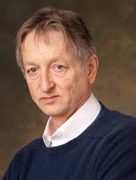
“The brain has about 10^14 synapses and we only live for about 10^9 seconds. So we have a lot more parameters than data. This motivates the idea that we must do a lot of unsupervised learning since the perceptual input (including proprioception) is the only place we can get 10^5 dimensions of constraint per second.”
Geoffrey Hinton
(in his 2014 AMA on Reddit)

Slide 16
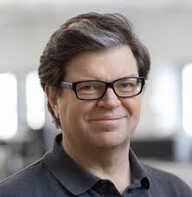
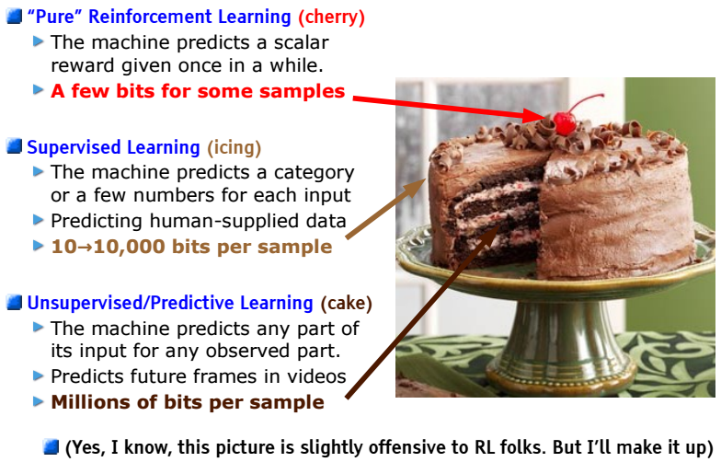
LeCake
Yann LeCun
Need tremendous amount of information to build machines that have common sense and generalize
[LeCun-20161205-NeurIPS-keynote]
Notes:
A caveat with the bits argument: Not all bits are equal. Supervised Learning and Reinforcement Learning bits are much more “useful” bits than unsupervised raw input “bits”.

Slide 17
“Ideal Intelligence”
“Ideal Intelligence” is all about compression (finding all patterns)
Finding all patterns = short description of raw data (low Kolmogorov Complexity)
Shortest code-length = optimal inference (Solomonoff Induction)
Extensible to optimal action making agents (AIXI)
Assume we pretrain unsupervised on Data Distribution D1 and then finetune on Data Distribution D2 Then: if D1 and D2 are related, compressing D2 conditioned on D1 should be more efficient than compressing D2 outright Hence: pretraining on D1 should aid faster learning of D2

Slide 18
Aside from theoretical interests
Deep Unsupervised Learning has many powerful applications
Generate novel data
Conditional Synthesis Technology (WaveNet, GAN-pix2pix)
Compression
Improve any downstream task with un(self)supervised pre-training
Production level impact: Google Search powered by BERT
Flexible building blocks

Slide 19
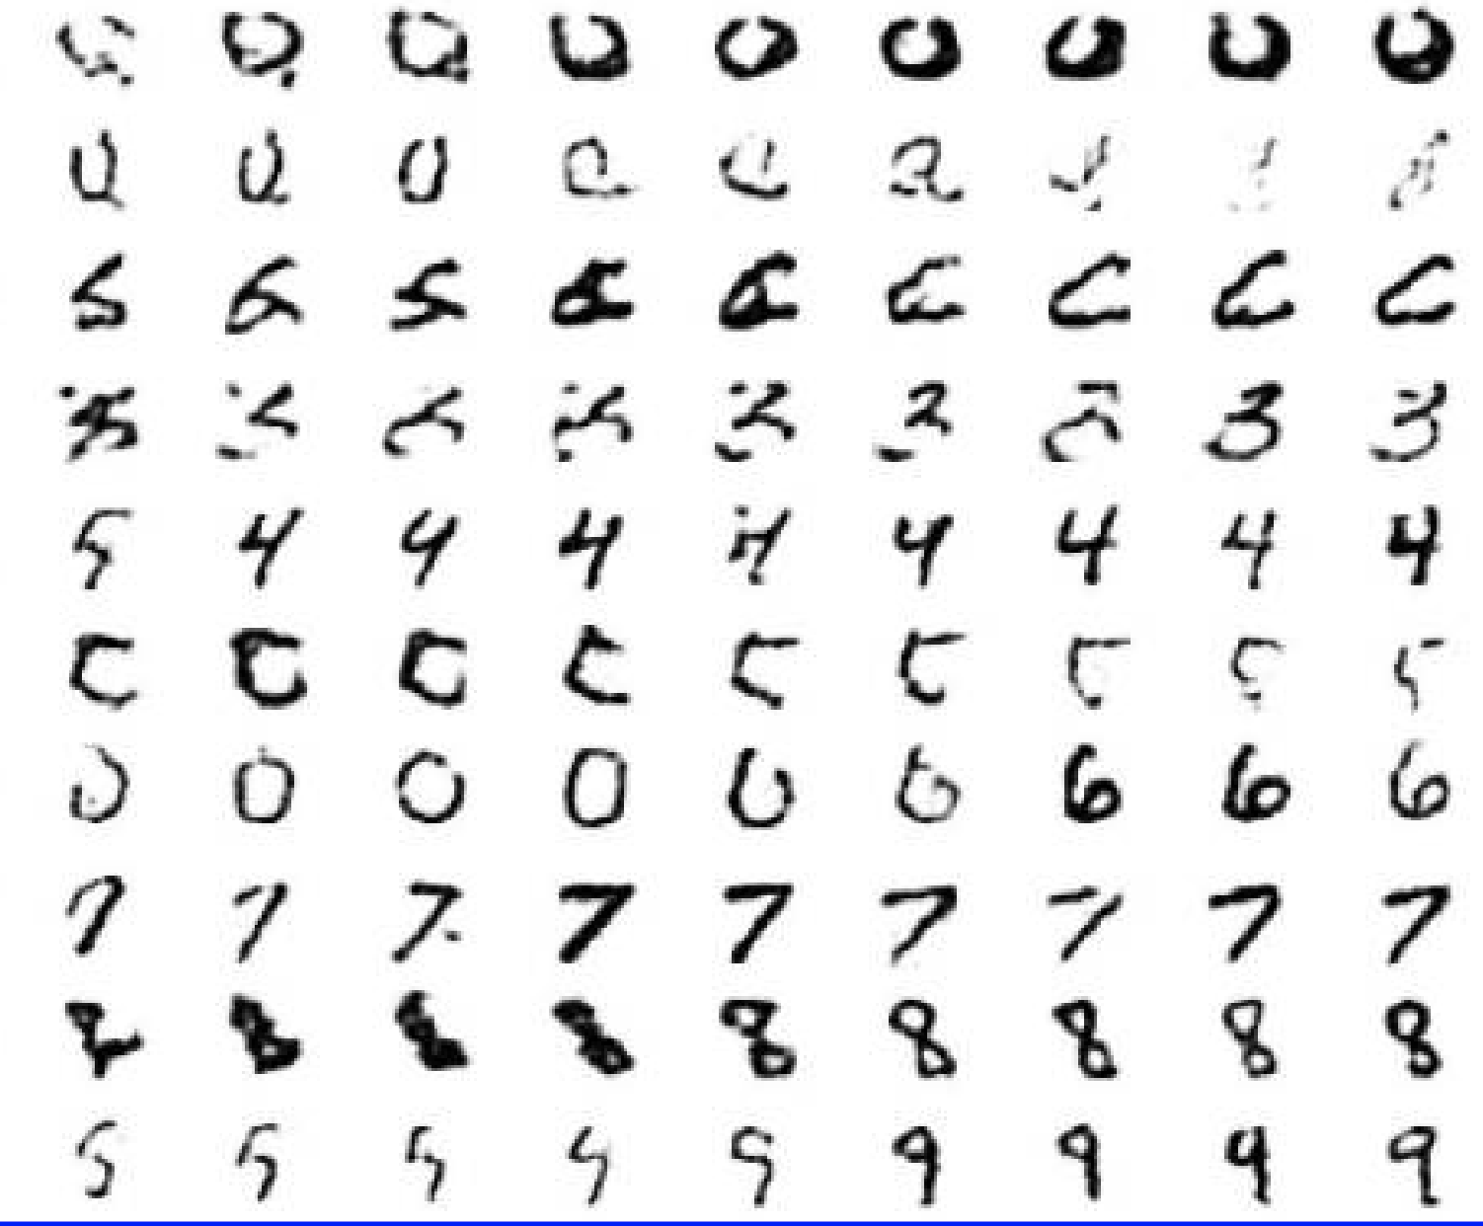
Generate Images
[Deep Belief Nets, Hinton, Osindero, Teh, 2006]

Slide 20
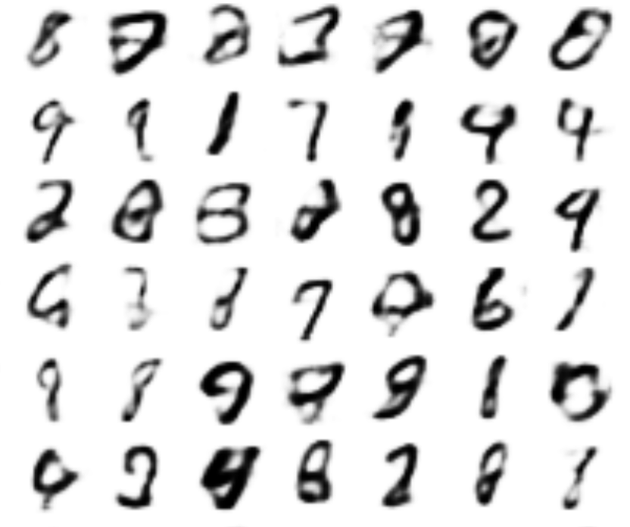
Generate Images
[VAE, Kingma and Welling, 2013]

Slide 21
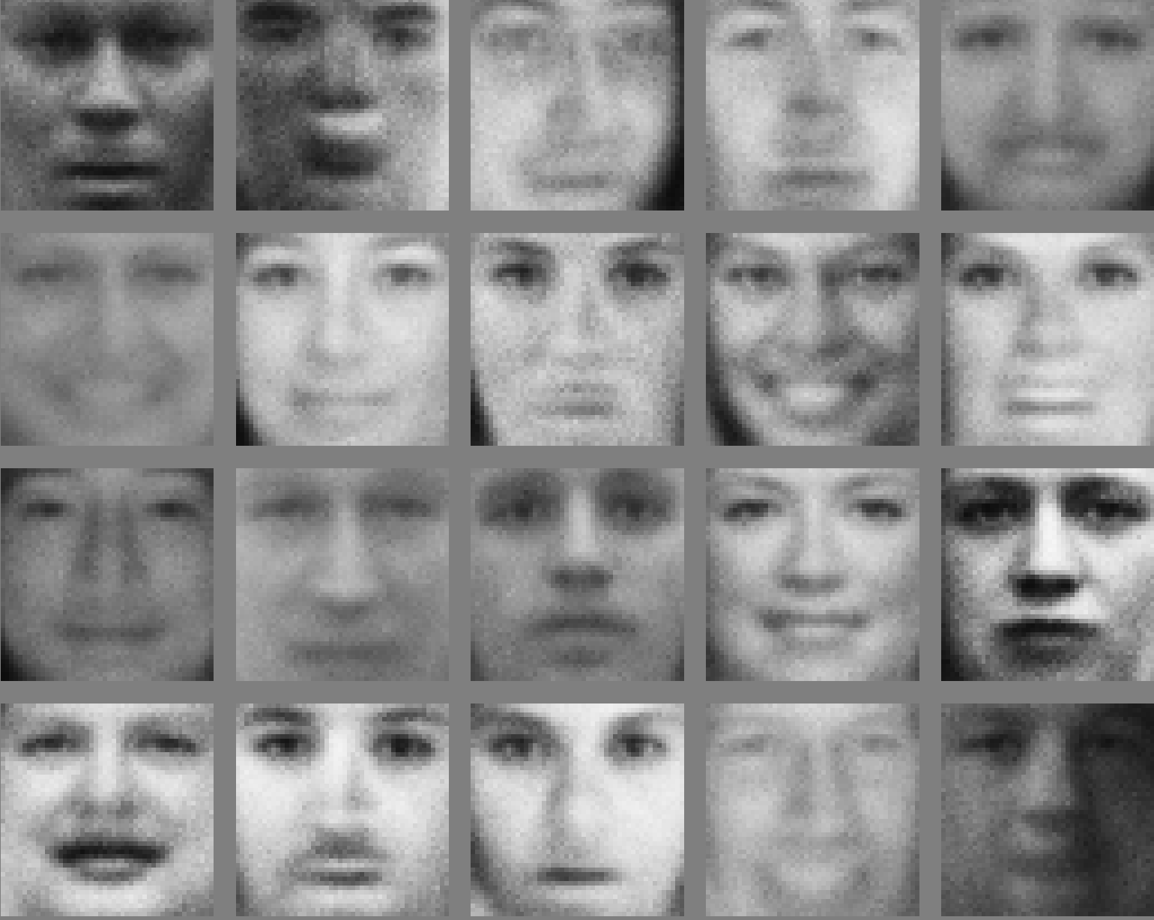
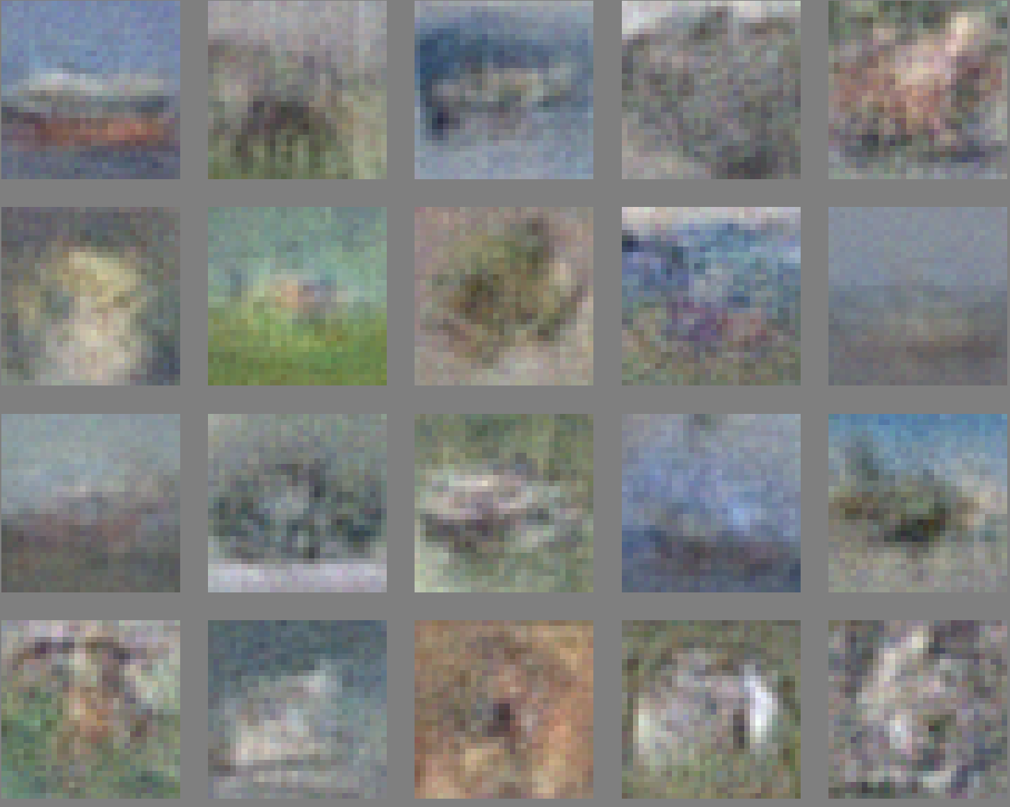
Generate Images
[GAN, Goodfellow et al. 2014]

Slide 22
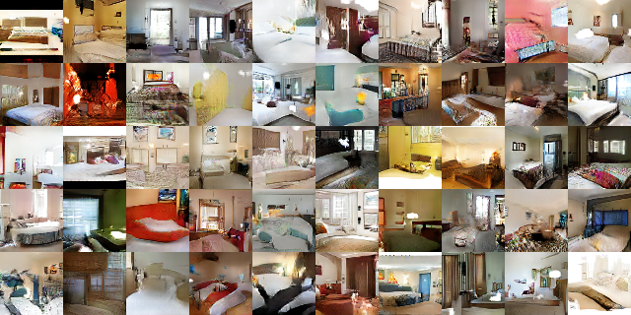
Generate Images
[DCGAN, Radford, Metz, Chintala 2015]

Slide 23
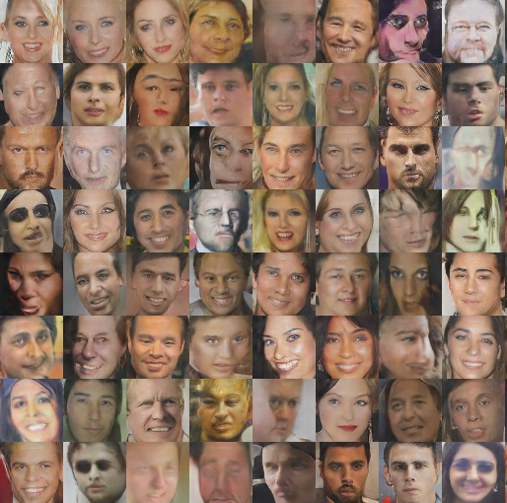
Generate Images
[DCGAN, Radford, Metz, Chintala 2015]

Slide 24
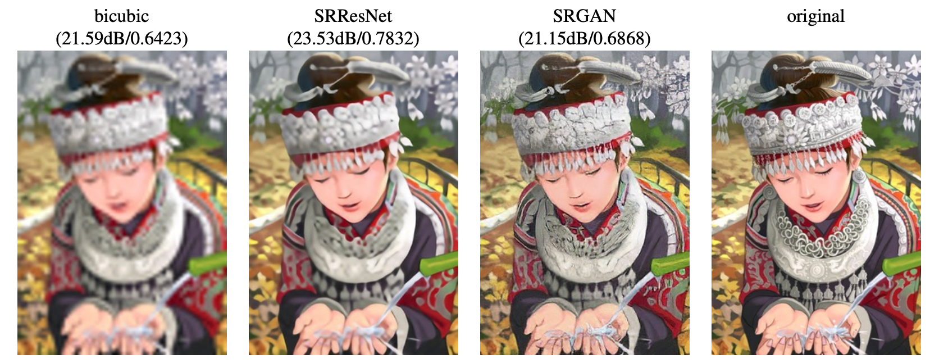
Generate Images
[Ledig, Theis, Huszar et al, 2017]

Slide 25

Generate Images
[CycleGAN: Zhu, Park, Isola & Efros, 2017]

Slide 26
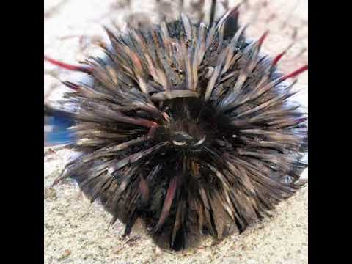
Generate Images
[BigGAN, Brock, Donahue, Simonyan, 2018]

Slide 27
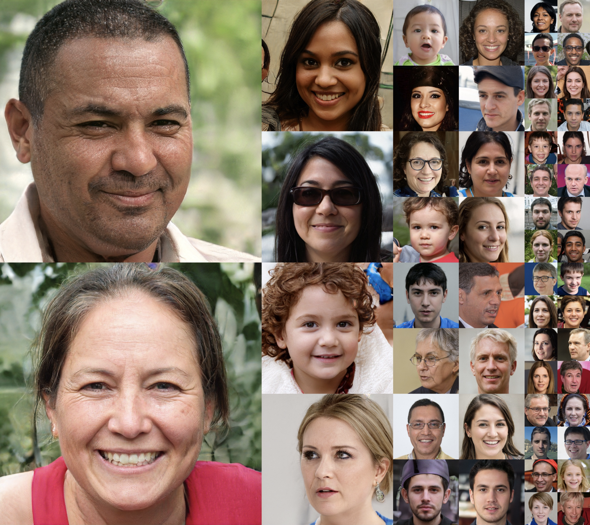
Generate Images
[StyleGAN, Karras, Laine, Aila, 2018]

Slide 28
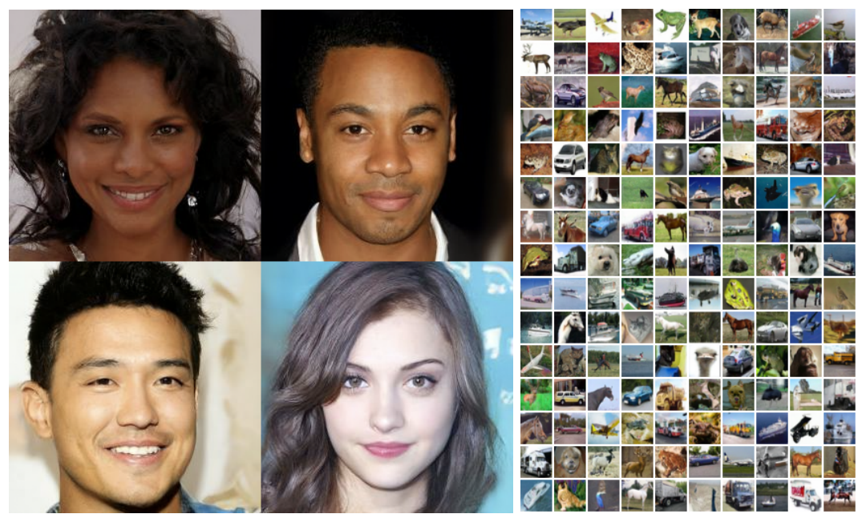
Generate Images
[Ho, Jain, Abbeel, 2020 Denoising Diffusion Probabilistic Models]

Slide 29

Text to Image
“a masterful oil painting a persian exotic cat discovering their astounding crypto losses while checking their phone”

Slide 30
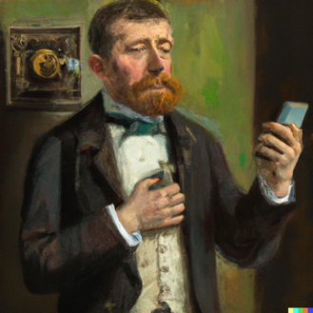
Text to Image
“A Victorian man struggles with his addiction to TikTok”

Slide 31

Text to Image
“Darth Vader realising he's forgotten to add an attachment to the email”

Slide 32
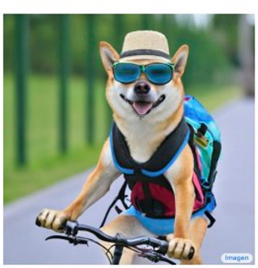
Text to Image
“A photo of a Shiba Inu dog with a backpack riding a bike. It is wearing sunglasses and a beach hat”

Slide 33
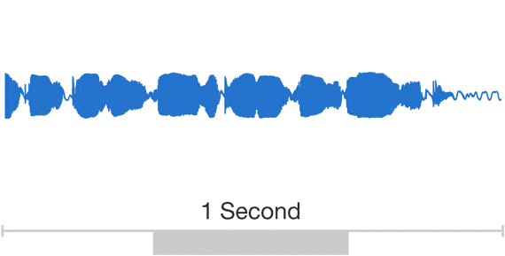
Generate Audio
Parametric
WaveNet
[WaveNet, Oord et al., 2018]
Notes:
WaveNet is based on pixelrnn. We want to generate audio autoregressively. use dilated convolutions to capture the long range dependencies. use causal convolutions. (we will see similar things in language modelling later, autoregressive models). better than RNNs because we dont have to iterate for every data point. audio data is the raw audio waveform.

Slide 34
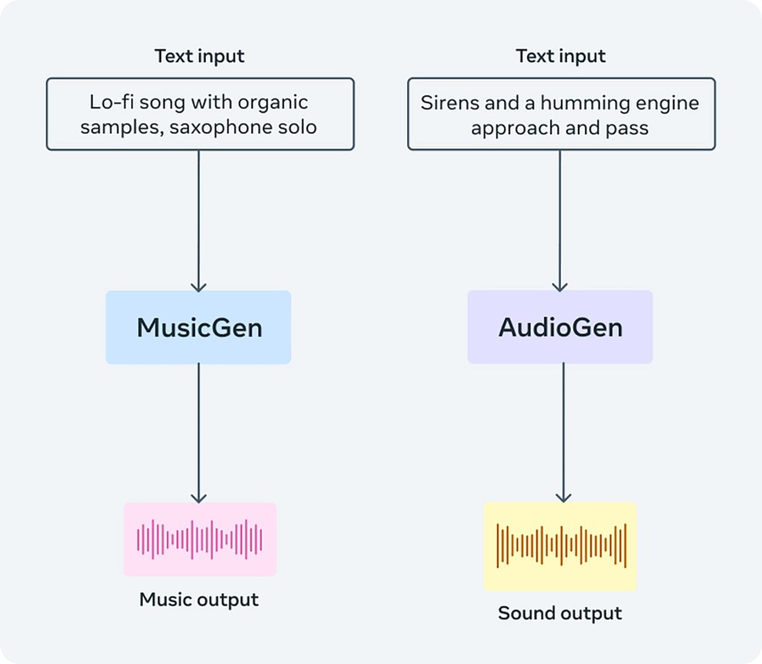
Text to Audio
[AudioCraft, Copet et al., 2023]
Notes:
https://github.com/facebookresearch/audiocraft
Learn discrete audio tokens, and then do language model style generation.

Slide 35
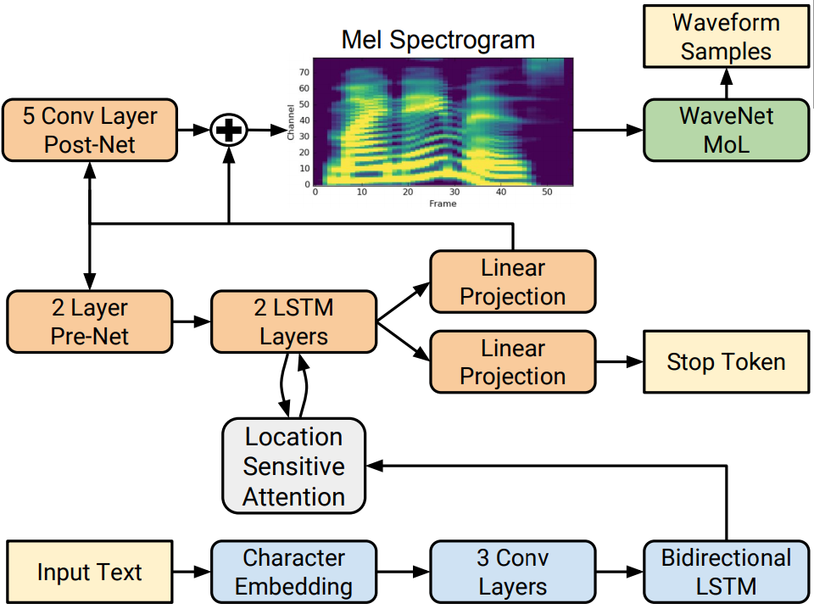
Text to Speech
[Tacotron2 , Shen et al., 2018]
Notes:
Builds off wavenet earlier. But maps characters onto the wave files.

Slide 36
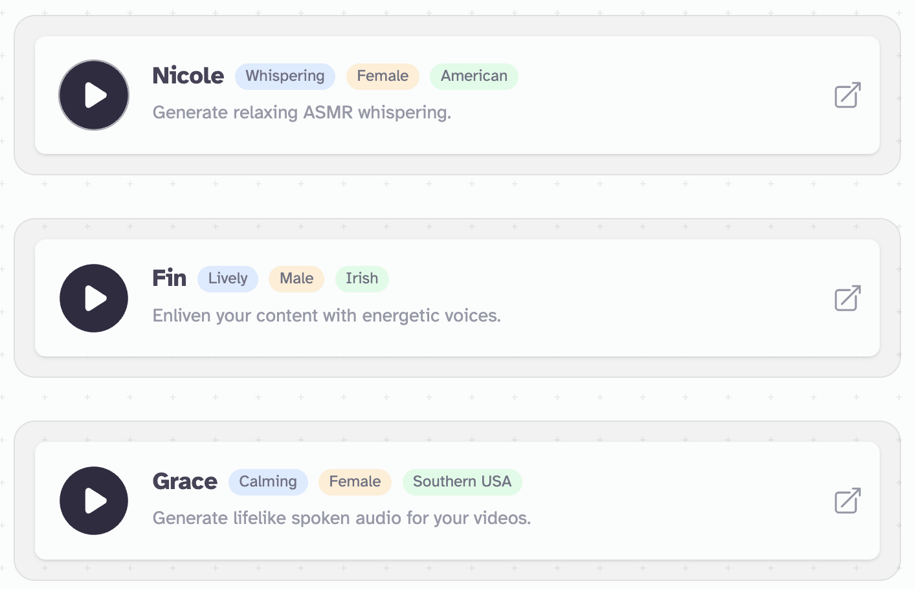
Text to Speech
https://elevenlabs.io/
Notes:
Builds off wavenet earlier. But maps characters onto the wave files.

Slide 37
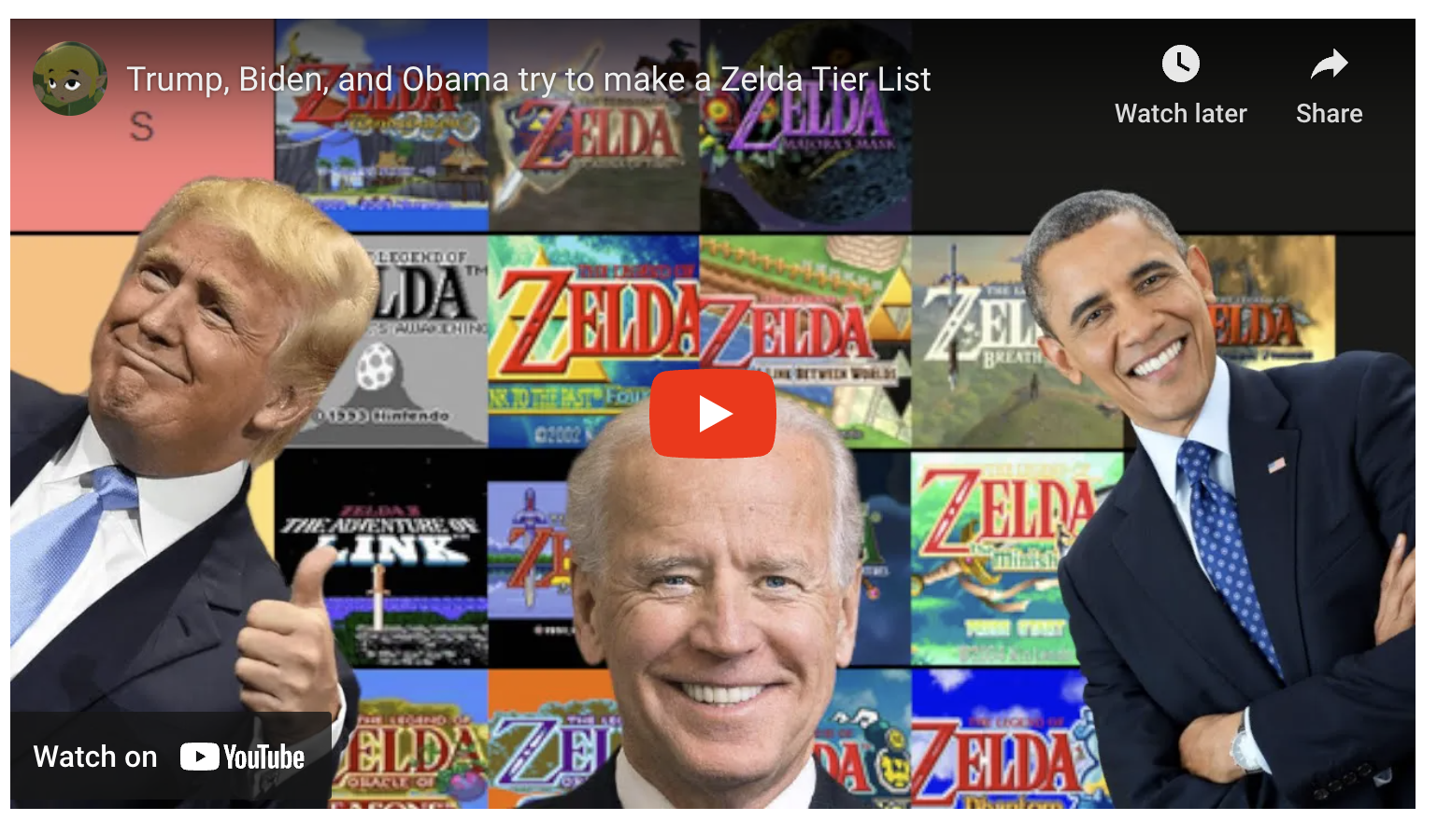
Voice Conversion
Notes:
Builds off wavenet earlier. But maps characters onto the wave files.

Slide 38
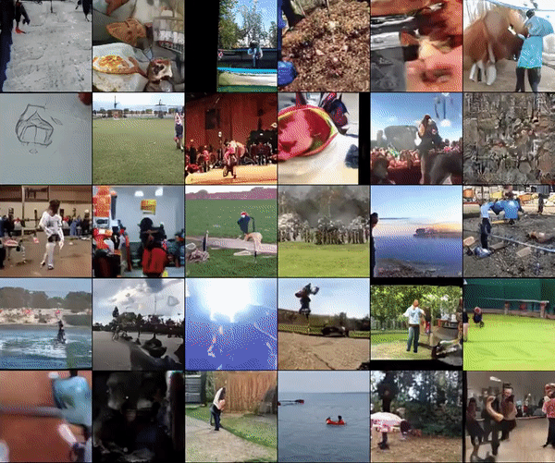
Generate Video
DVD-GAN: Adversarial Video Generation on Complex Datasets, Clark, Donahue, Simonyan, 2019

Slide 39
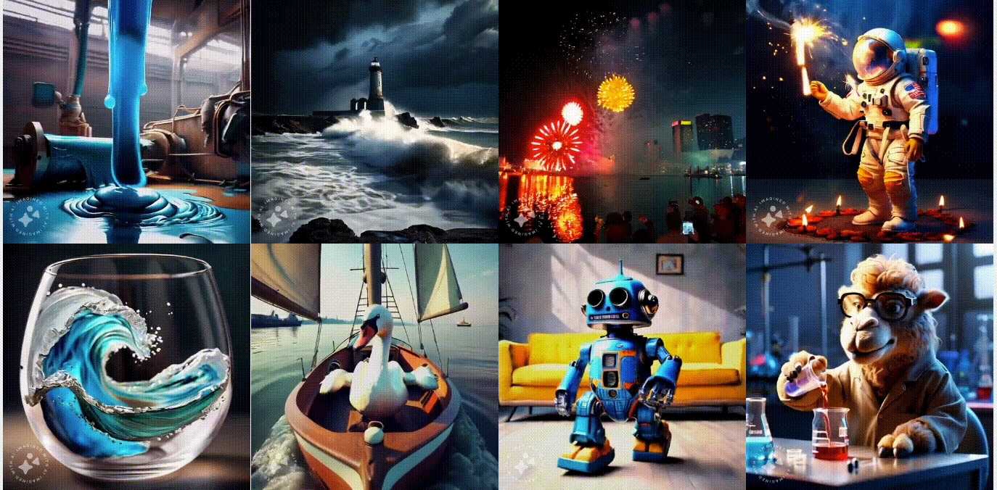
Text to Video
EMU VIDEO: Factorizing Text-to-Video Generation by Explicit Image Conditioning. Girdhar et al, 2023

Slide 40
Text to Video
VideoPoet: A Large Language Model for Zero-Shot Video Generation. Kondratyuk et al, 2023
Notes:
Video tokenizer and audio tokenizer, then language modelling style prediction.

Slide 41
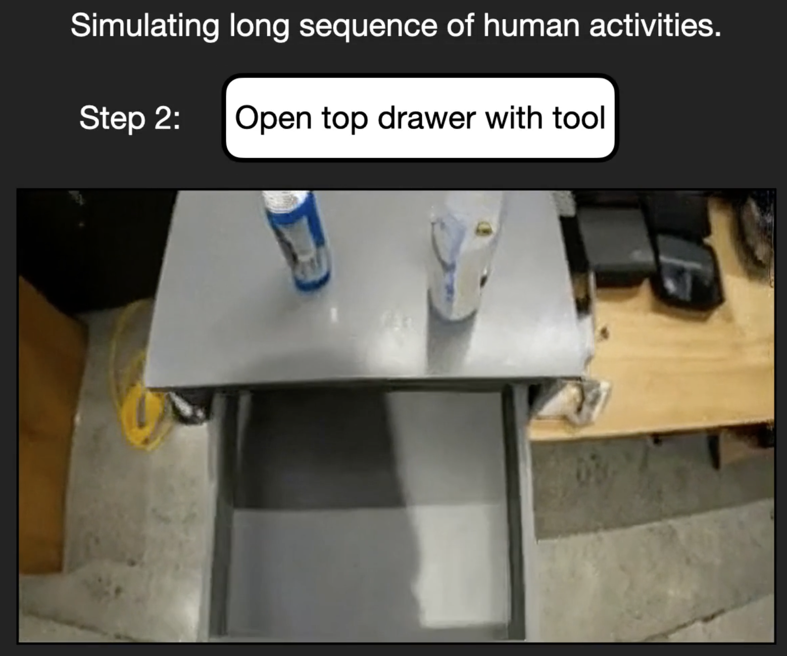
Video Sim for Control
UniSim: Learning Interactive Real-World Simulators. Yang et al, 2023
Notes:
Video tokenizer and audio tokenizer, then language modelling style prediction.

Slide 42
Generate Text
PANDARUS: Alas, I think he shall be come approached and the day When little srain would be attain'd into being never fed, And who is but a chain and subjects of his death, I should not sleep. Second Senator: They are away this miseries, produced upon my soul, Breaking and strongly should be buried, when I perish The earth and thoughts of many states. DUKE VINCENTIO: Well, your wit is in the care of side and that.
[Char-rnn, karpathy, 2015]

Slide 43
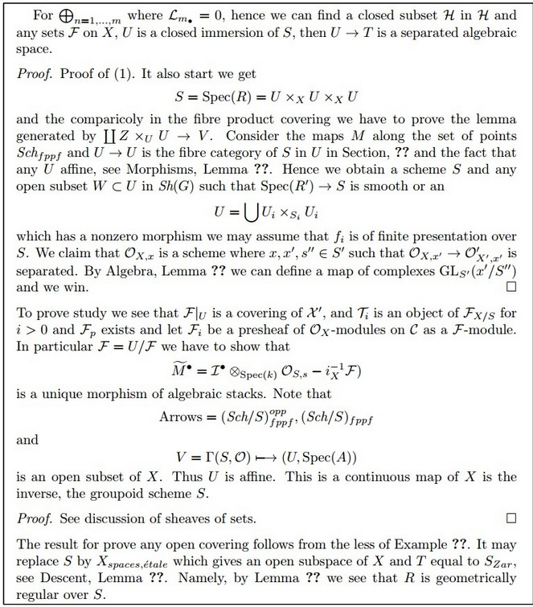
Generate Math
\begin{proof} We may assume that $\mathcal{I}$ is an abelian sheaf on $\mathcal{C}$. \item Given a morphism $\Delta : \mathcal{F} \to \mathcal{I}$ is an injective and let $\mathfrak q$ be an abelian sheaf on $X$. Let $\mathcal{F}$ be a fibered complex. Let $\mathcal{F}$ be a category. \begin{enumerate} \item \hyperref[setain-construction-phantom]{Lemma} \label{lemma-characterize-quasi-finite} Let $\mathcal{F}$ be an abelian quasi-coherent sheaf on $\mathcal{C}$. Let $\mathcal{F}$ be a coherent $\mathcal{O}_X$-module. Then $\mathcal{F}$ is an abelian catenary over $\mathcal{C}$. \item The following are equivalent \begin{enumerate} \item $\mathcal{F}$ is an $\mathcal{O}_X$-module. \end{lemma}
[Char-rnn, karpathy, 2015]

Slide 44
Generate Text
Prompt [human written]: A train carriage containing controlled nuclear materials was stolen in Cincinnati today. Its whereabouts are unknown.
GPT-2: The incident occurred on the downtown train line, which runs from Covington and Ashland stations. In an email to Ohio news outlets, the U.S. Department of Energy said it is working with the Federal Railroad Administration to find the thief.
‘The theft of this nuclear material will have significant negative consequences on public and environmental health, our workforce and the economy of our nation,’ said Tom Hicks, the U.S. Energy Secretary, in a statement. ‘Our top priority is to secure the theft and ensure it doesn’t happen again.’
The stolen material was taken from the University of Cincinnati’s Research Triangle Park nuclear research site, according to a news release from Department officials.
The Nuclear Regulatory Commission did not immediately release any information. According to the release, the U.S. Department of Energy’s Office of Nuclear Material Safety and Security is leading that team’s investigation.
‘The safety of people, the environment and the nation’s nuclear stockpile is our highest priority,’ Hicks said. ‘We will get to the bottom of this and make no excuses.’
[OpenAI’s GPT2 -- Radford, Wu, Child, Luan, Amodei, Sutskever, 2019]

Slide 45
Generate Text
Prompt (human written): Recycling is good for the world, no, you could not be more wrong.
GPT-2: Recycling is NOT good for the world. It is bad for the environment, it is bad for our health, and it is bad for our economy. I’m not kidding. Recycling is not good for the environment. It is destructive to the earth and it is a major contributor to global warming. Recycling is not good for our health. It contributes to obesity and diseases like heart disease and cancer. Recycling is bad for our economy. It increases the cost of a product, and in turn, the price of everything that is made with that product. Recycling is not good for our nation. We pay a tremendous price for the privilege of having the world’s most advanced and efficient recycling system. Recycling is a huge, colossal waste of time, energy, money, and resources.
[OpenAI’s GPT2 -- Radford, Wu, Child, Luan, Amodei, Sutskever, 2019]

Slide 46
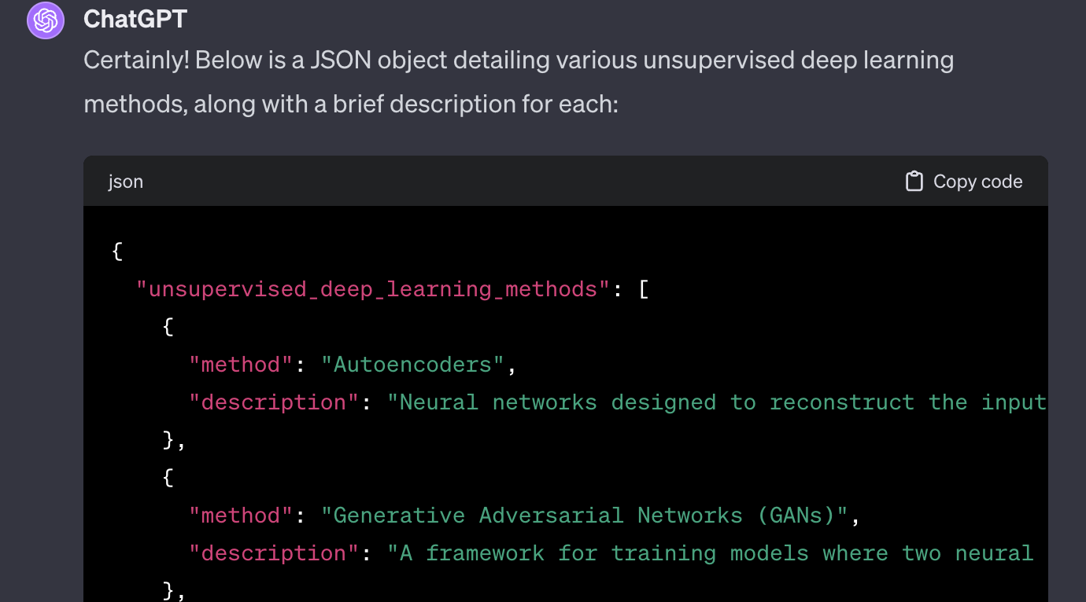
JSON Generation
[OpenAI ChatGPT, 2023]

Slide 47
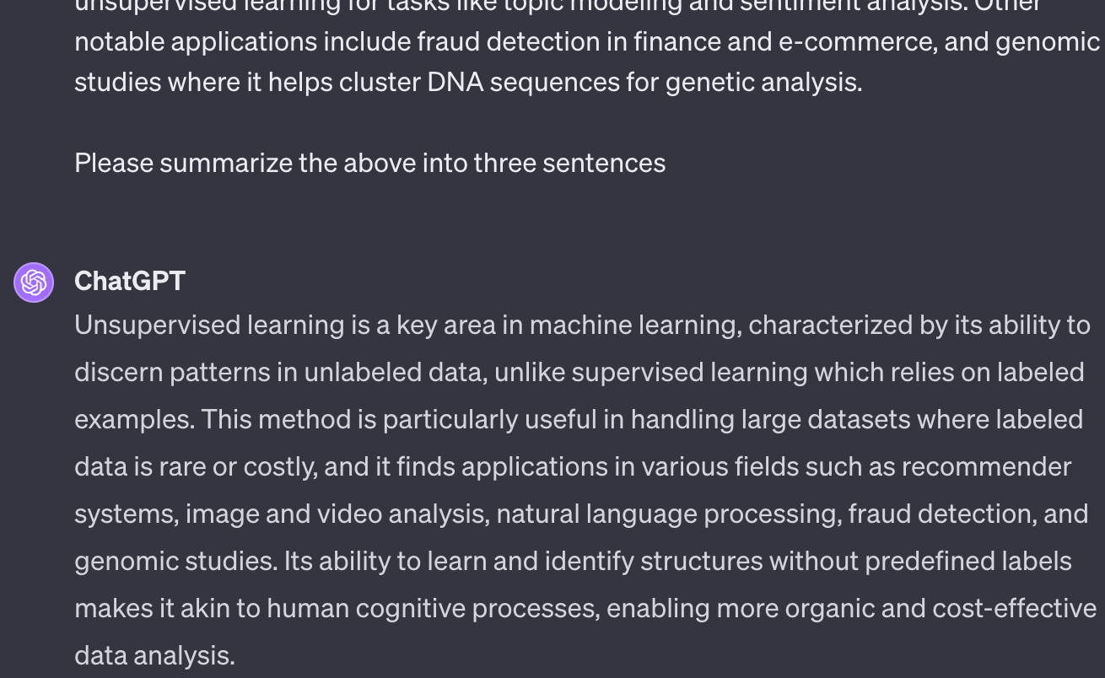
Long Form Summarization
[OpenAI ChatGPT, 2023]

Slide 48
Try it yourself
https://chat.openai.com
https://perplexity.ai

Slide 49
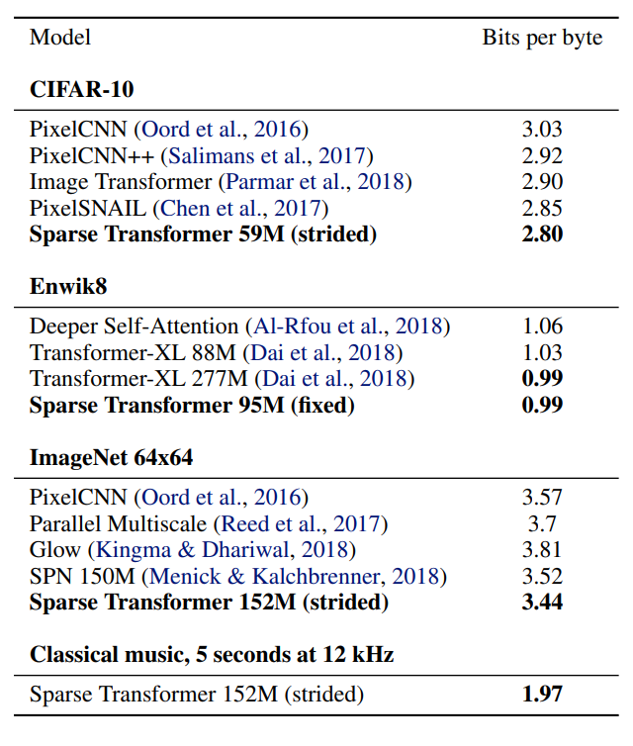
Compression - Lossless
Generative models provide better bit-rates than distribution-unaware compression methods like JPEG, etc.

Slide 50
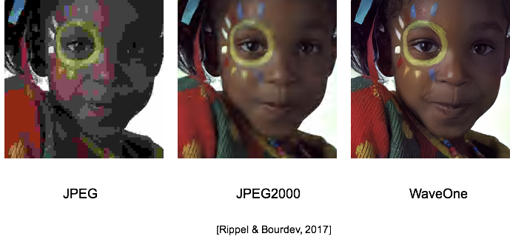
Compression - Lossy

Slide 51
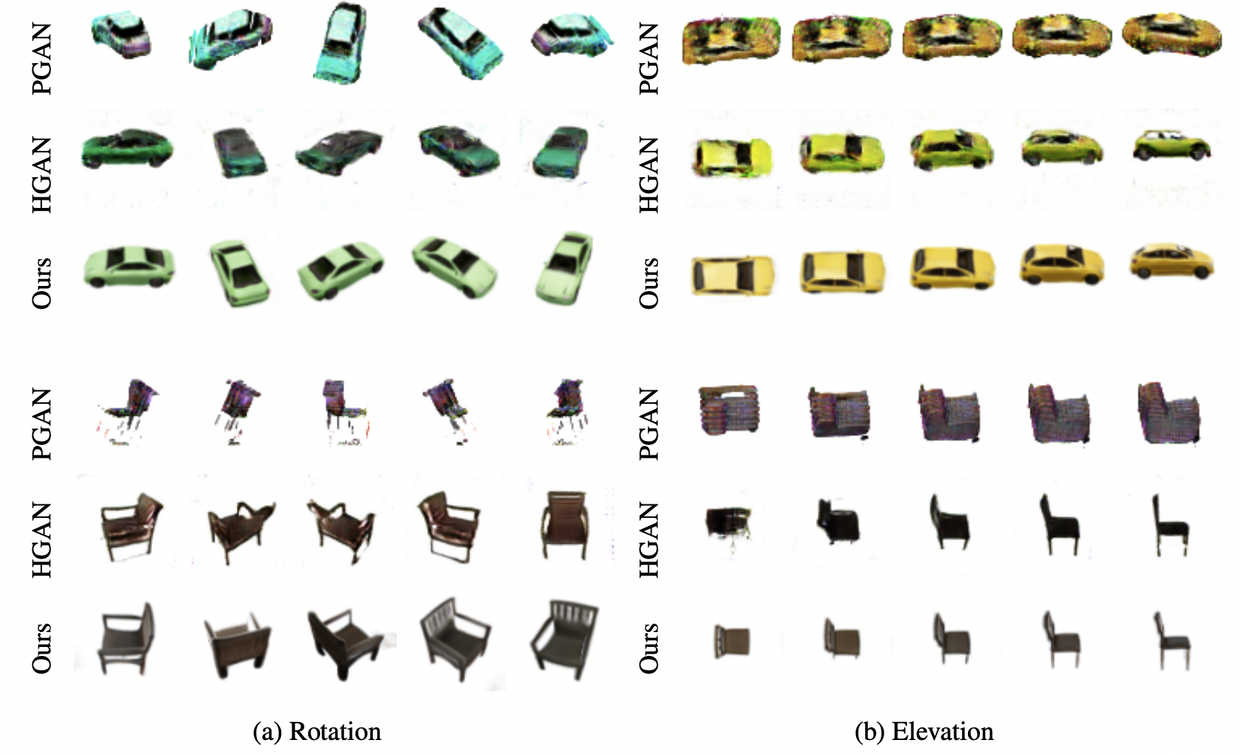
3D Generation
[GRAF, Schwarz et al, 2020]

Slide 52
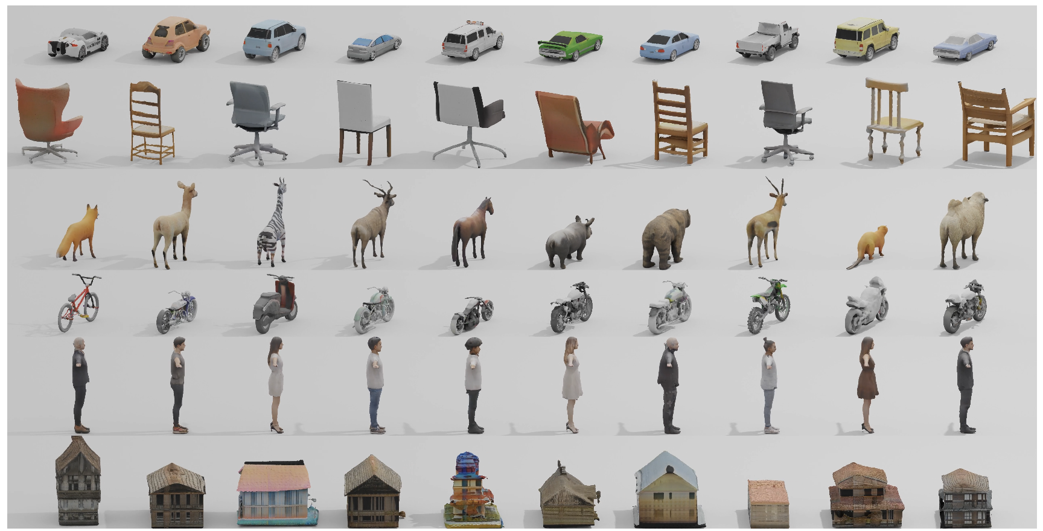
3D Generation
[GET3D, Gao et al, 2022]

Slide 53
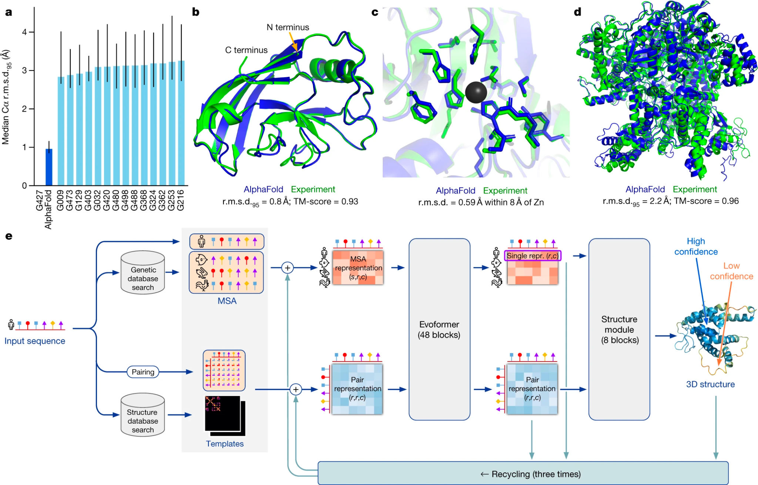
AI for Science
[Highly accurate protein structure prediction with AlphaFold, Jumper Et Al, 2021]

Slide 54
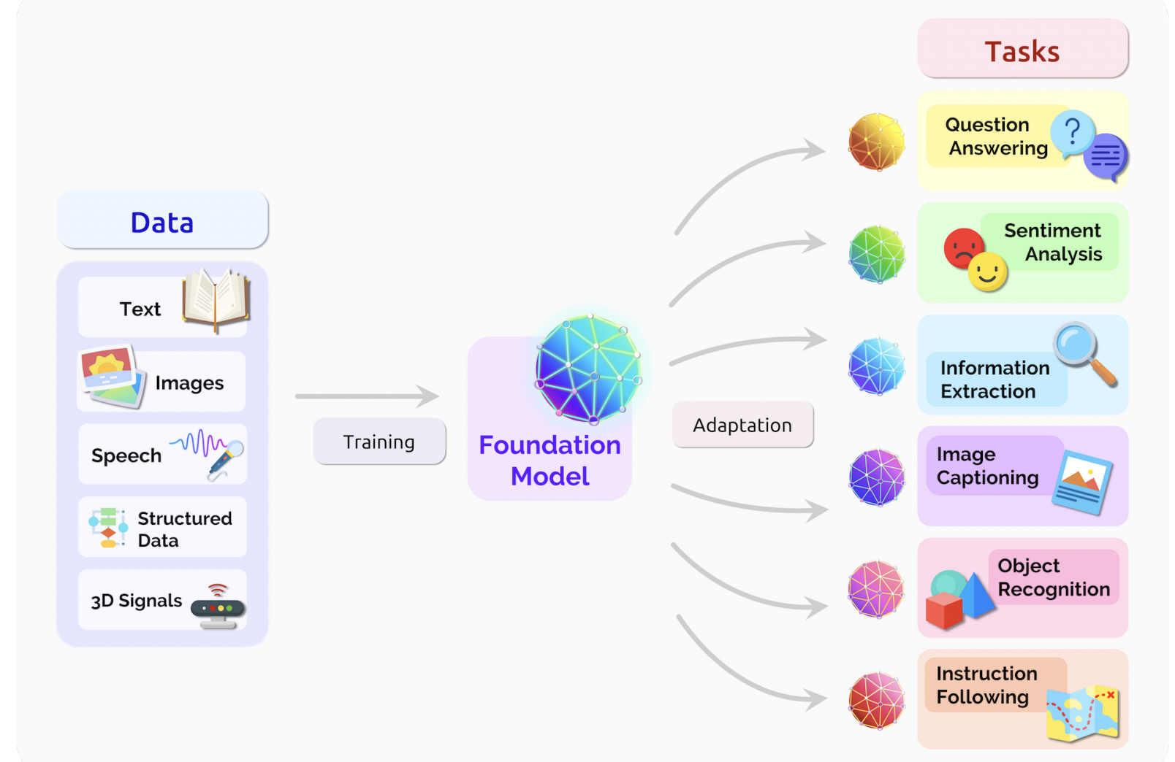
Pretrain, then adapt
[On the Opportunities and Risks of Foundation Models, Bommasani et. al, 2022]

Slide 55
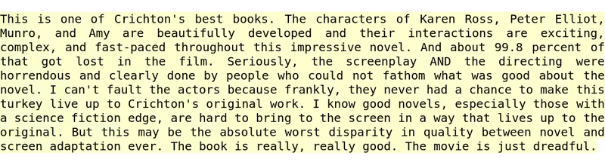
Downstream Task - Sentiment Detection
[Radford et al., 2017]

Slide 56
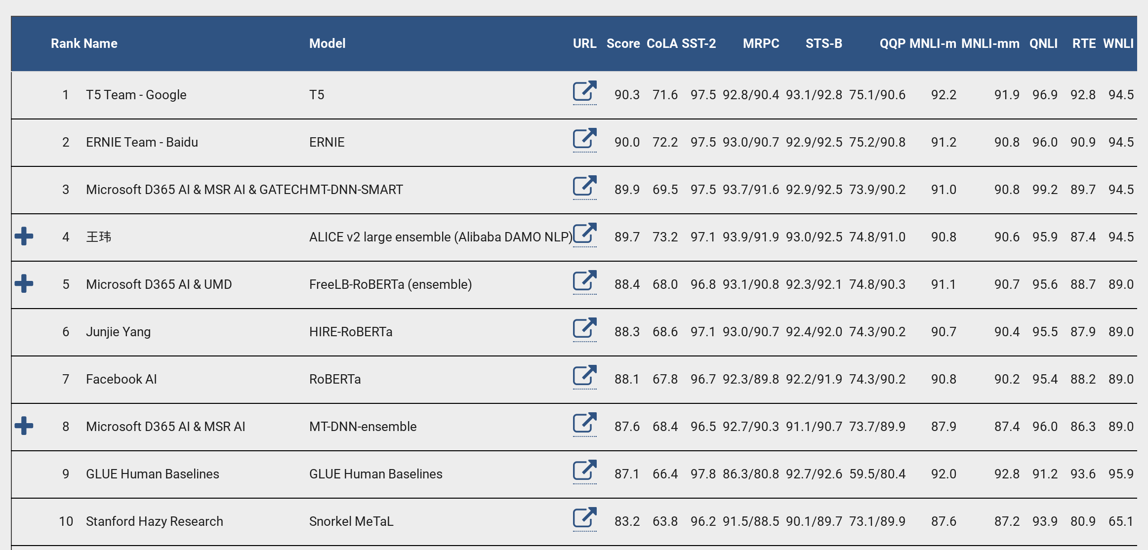
Downstream Tasks - NLP (BERT Revolution)
[https://gluebenchmark.com/leaderboard]

Slide 57
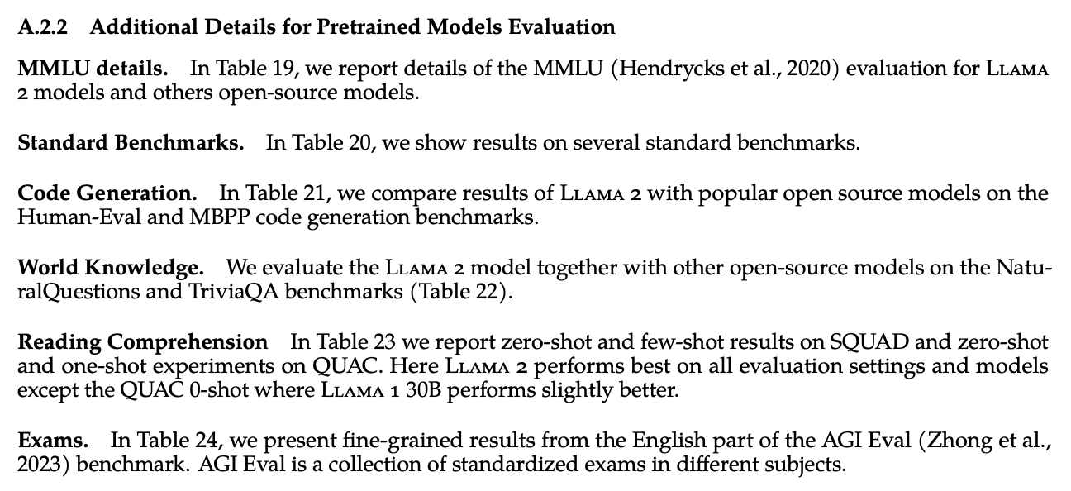
Downstream Tasks - Few Shot
[LLAMA 2, 2023]

Slide 58
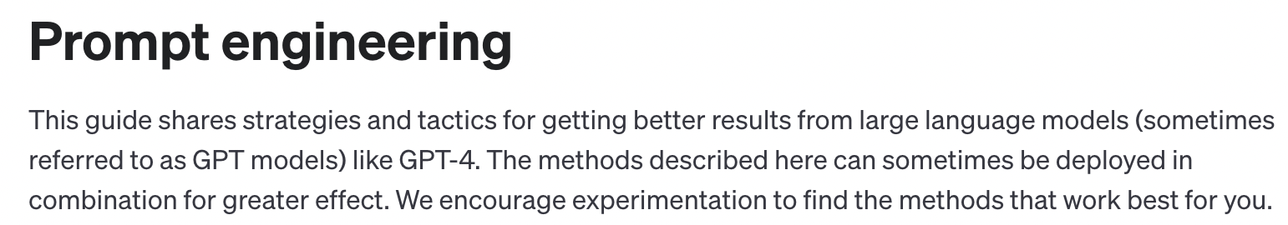
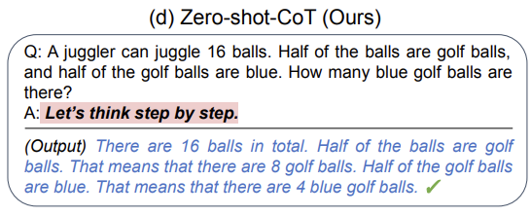
Downstream Tasks - Prompting
[https://platform.openai.com/docs/guides/prompt-engineering]
[Large Language Models are Zero-Shot Reasoners, Kojima et al, 2023]

Slide 59
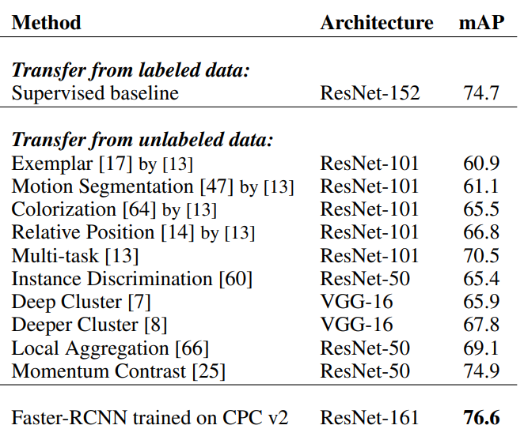
Downstream Tasks - Vision (Contrastive)
"If, by the first day of autumn of 2015, a method will exist that can match or beat the performance of R-CNN on Pascal VOC detection, without the use of any extra, human annotations (e.g. ImageNet) as pre-training, Mr. Malik promises to buy Mr. Efros one (1) gelato (2 scoops: one chocolate, one vanilla)."
Table: Data-Efficient Image Recognition using CPC (Henaff, Srinivas, et al)

Slide 60
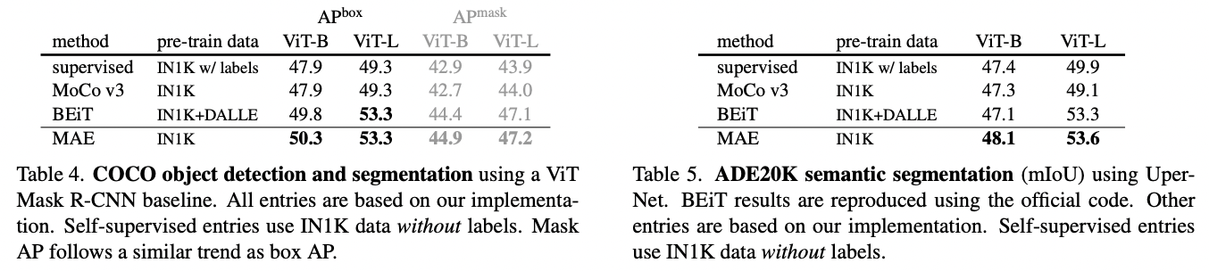
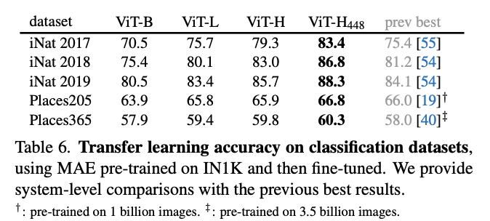
Downstream Tasks - Vision (MAE)
[Masked Autoencoders Are Scalable Vision Learners, He et al, 2021]

Slide 61
Unsupervised Learning Scales with Data

Slide 62
Summary
Unsupervised Learning: Rapidly advancing field thanks to compute; deep learning engineering practices; datasets; lot of people working on it
Not just an academic interest topic: Language Modeling, Image Generation, Vision / Language / Multimodal Pre-Training are all working really well and have production level impact
What is true now may not be true even a year from now example1: self-supervised pre-training was way worse than supervised in computer vision tasks like detection/segmentation until 2019, now it is better example2: representation learning for vision through masking didn’t work until Kaiming He et al made it work November 2021
Autoregressive Models, Flows, VAEs, GANs, Diffusion Models still have significant room for surprising capabilities, especially in newer domains such as multi-modal, video, robotics, bio, sciences. Great time to work on them.
Core of Unsupervised Learning might still have some major innovations ahead (e.g. last offering (2020) we wrote Diffusion Models paper right after semester wrapped up)

